Slide 1
Back to the basics
Explaining design patterns with real life examples

Slide 2
Generalties
Design patterns are not a one size fits all solution
Each design pattern is a specific solution to a specific problem
It’s important to be identify of the need and/or problem that each pattern attempts to solve

Slide 3
Prototype
https://refactoring.guru/design-patterns/prototype

Slide 4
The need:
For one reason or another, you reach a point in your application where you need to duplicate/clone an object.

Slide 5
The problems:
Cloning the object directly “pollutes” the code. The client code shouldn’t be the one responsible for cloning the object.
The bigger the object, the more lines you need to clone it, the more it impacts code readability.
Cloning the object means knowing how to clone it. This couples the client code to the class.
You can’t clone private or protected fields, let alone interfaces or abstract classes.

Slide 6
The solution, and why it’s recommended
Let the object handle its own cloning! ☺
Code is not polluted.
All the lines (no matter how many) are inside a Clone() method. Doesn’t impact readability.
Client code doesn’t need to know what’s inside the object.
The Clone() method can see private/protected fields.
The Clone() method can be overwritten in child classes.

Slide 7
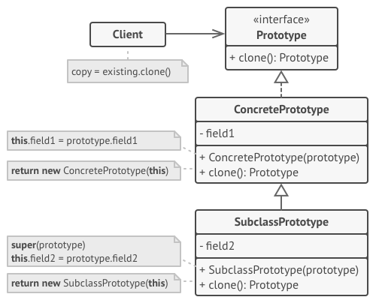
How to do it
Create the “Prototype” interface having a Clone() method
Implement this interface and its method in your class.
Replace the cloning in the client code with object.Clone()
Note: It is up to you if the clone method should perform a shallow copy or a deep copy.
Alternatively, your interface could expose both “ShallowCopy()” and “DeepCopy()”.

Slide 8
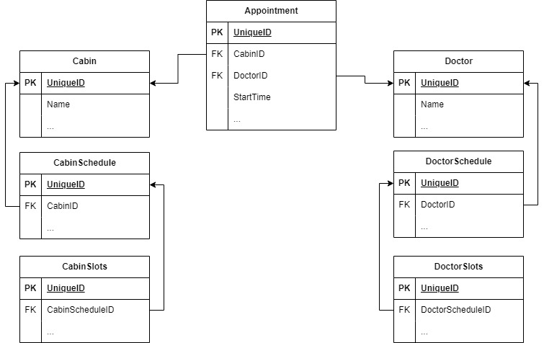
Real life example Context:
The project was a telemedicine application allowing a patient in a cabin to connect to a remote doctor.
The system supported cabin and doctor schedules, and a patient appointment required both.

Slide 9
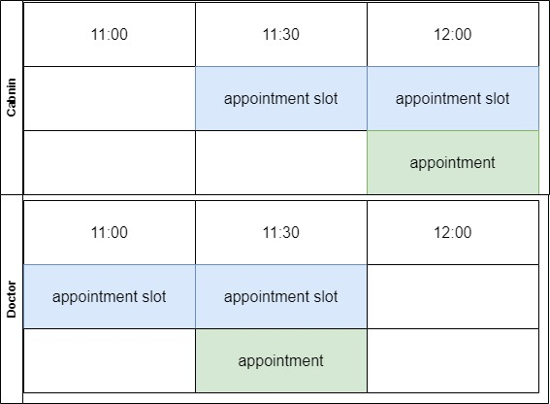
Real life example Context:
The project was a telemedicine application allowing a patient in a cabin to connect to a remote doctor.
The system supported cabin and doctor schedules, and a patient appointment required both.
On the admin dashboard was a “calendar” view, allowing an admin to see cabin and doctor schedules + appointments on the same page.
The problem: The same appointment entity had to be rendered in two places on the same page.

Slide 10
Real life example The solution:
Exactly as the pattern suggests:
Implemented the .Net ICloneable interface in the Appointment class.
Implemented the Clone() method as required
The client code remained clean and focused, simply calling appointment.Clone() and adjusting the new object as needed.

